Slide 1
OBI tutorial
ICBO 2011
7/27/2011, Buffalo, NY

Slide 2
Tutorial Overview
OBI – project organization and class structure
OBI applications
Break
Hands on session

Slide 3
Software preparation (optional)
Before hands-on session
Install Protégé 4.1
Load OBI
Run Reasoner
Let us know if you have problems; we can help during the break

Slide 4
OBI –high level overview

Slide 5
OBI – a user driven project
19 communities that recognized they were trying to solve the same / related problems
Members typically have one or more applications that drive OBI development
6 year effort, 1-2 phone calls per week, 1-2 meetings per year
first stable release (Philly / 1.0) in Oct. 2009
→ Open project with constant addition of new communities, please consider joining!

Slide 6
OBI Timeline
MO/ MAGE
FuGO
FuGE
OBI
2004 2005 2006 2007
MAGE
Jamboree
Hinxton
Dec
1st FuGO
Workshop
Philadelphia
Feb.
2nd FuGO
Workshop
Hinxton
July
OBI Workshop San Diego Jan.
SOFG
Philadelphia
Oct
MAGE
Jamboree
Stanford
March
MGED 8
Bergen
Sept.
Transcriptomics (MGED)
Proteomics (PSI)
PSI
Siena
April
Cancer Genomics
Polypmorphisms
Genome Sequences
Crop Sciences
Toxicogenomics
Environmental Genomics
Nutrigenomics
(MGED RSBI)
Metabolomics
Flow Cytometry
Cellular Assays Immport IEDB Neuroinformatics
From Jan, 2007 OBI workshop in LIAI

Slide 7
OBI Timeline
Philly 2009 release
Vancouver 2010
San Diego 2011
2007 2008 2009 2010 2011
Workshops: Bethesda Vancouver EBI EBI Philly Vancouver San Diego
DENRIE -> IAO
OBO Foundry
MIREOT
J Biomed Sem.
Bio-imaging,
Clinical Investigations,
Electrophysiology,
Structural Biology
Robot
Scientists
Vaccines
Eagle-i

Slide 8
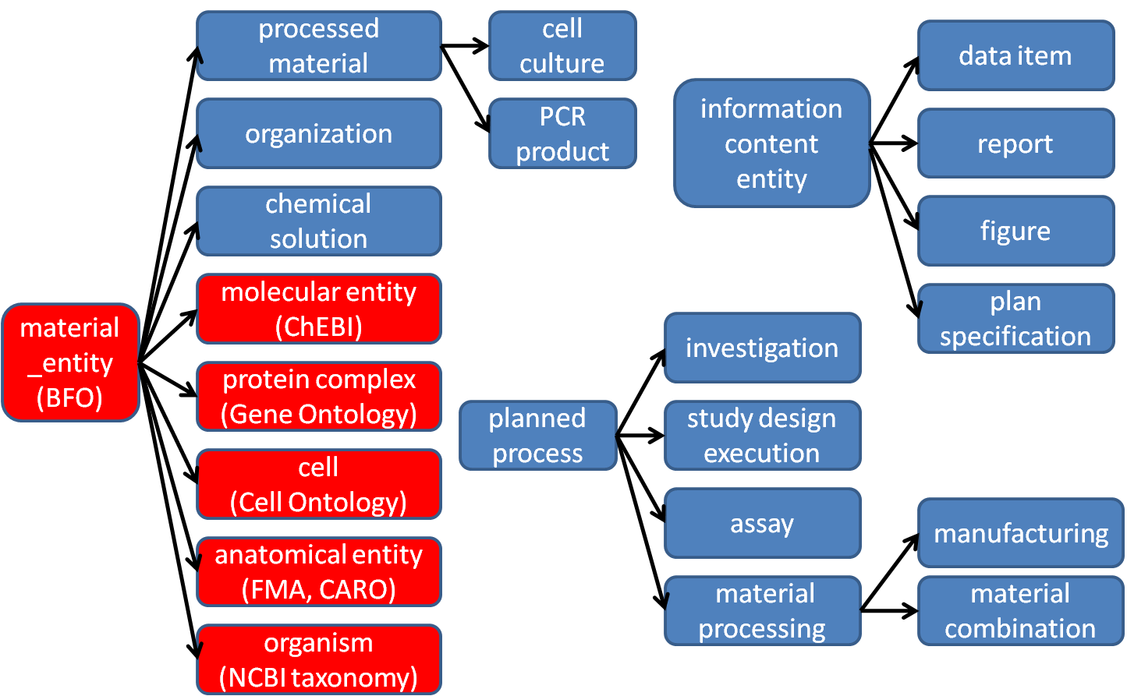
High level class hierarchy (partial)
Notes:
Remove planning

Slide 9
material entity
merged bfo:object, object part, object aggregate (what is a cell inside my body?)
import ‘natural biomaterials’ (MIREOT mechanism), e.g. organism (NCBI taxonomy), anatomical entity (FMA), molecular entity (ChEBI)
OBI’s primary scope
‘processed material entities’
output of a planned material transformation process
would not exist without intelligent life around
some ‘natural biomaterials’ can also be created (e.g. molecules) → no asserted disjoint
specimen, study subject
material entities about which information is gathered during an investigation
may or may not be processed materials

Slide 10
planned process
realizes a ‘plan specification’ which includes an ‘objective specification’ (describing the desired endpoint)
has specified inputs and outputs (=participants called out in the specification)
high level classes:
material processing (input: material, output: material)
assay (input: material, output: data item)
data transformation (input:data item output:data item)

Slide 11
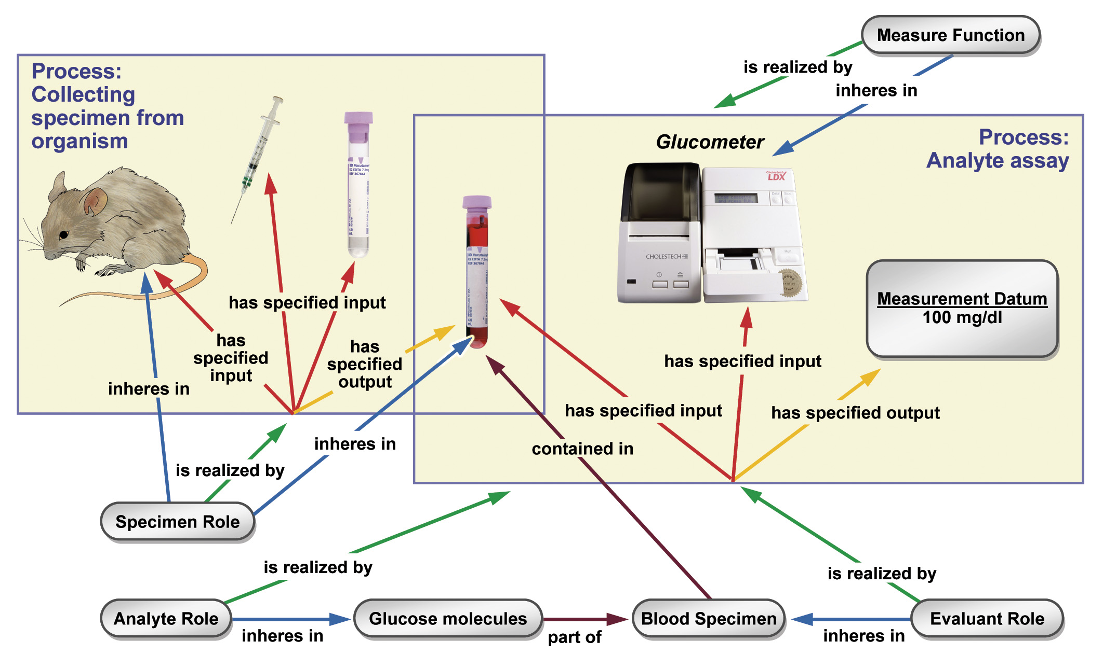

Slide 12
information content entity
Defined in IAO, a separate effort spawned from OBI, that is still tightly interlinked
every information content entity is_about something
Examples: plan specification, journal article, data item
OBI subclasses these, e.g.: study design, dependent variable specification, measurement datum

Slide 13
More classes
roles – specimen role, author role
functions – contain function, measurement function
organizations – manufacturer, regulatory agency

Slide 14
Summary
OBI is a multi-community project driven by the practical needs of its members with the goal to build a high quality, interoperable reference ontology
OBI high level classes are in place - solidified over several years - that cover all aspects of biomedical investigations
OBI is expanded to enable member applications and based on term requests

Slide 15
Overview of application presentations
IEDB - a manually curated database of epitope defining experiments
Using OBI to replace a controlled vocabulary, resulting in improved consistency, documentation and queries
EuPathDB - annotation of genomic-scale eukaryotic pathogen datasets
Designing a data submission form using OBI resulting in consistent and rich data entry with reduced user effort
eagle-i - representation of research resources
Using OBI as a basis to develop a new, interoperable annotation of research resources
Evidence Code Ontology
Linking to OBI to guide the development of an existing ontology

Slide 16
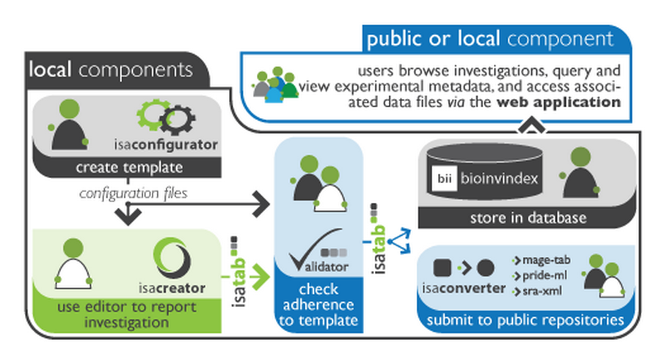
ISA – tools infrastructure (Philippe Rocca-Serra, could not make it)

Slide 17
Using OBI to enhance an existing database (Immune Epitope Database = IEDB)

Slide 18
This presentation demonstrates:
How to replace a controlled vocabulary with OBI classes
How this can be used to
Increase consistency in data curation
Avoid duplicates
Improve documentation to external users
Enhance search capabilities

Slide 19

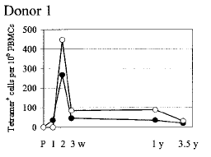
The IEDB catalogs immune epitope related experiments through manual curation of free text information into structured format
Epitope discovery contract submission
Literature curation
IEDB www.iedb.org
497,452 experiments
12,886 references
→ On track to curate all in scope articles by end of 2011

Slide 20
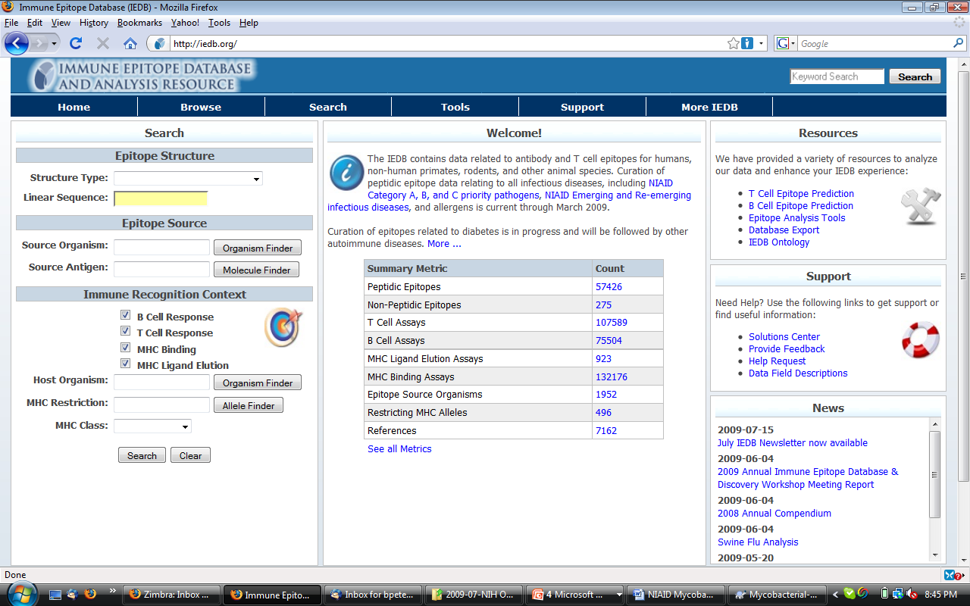

Slide 21
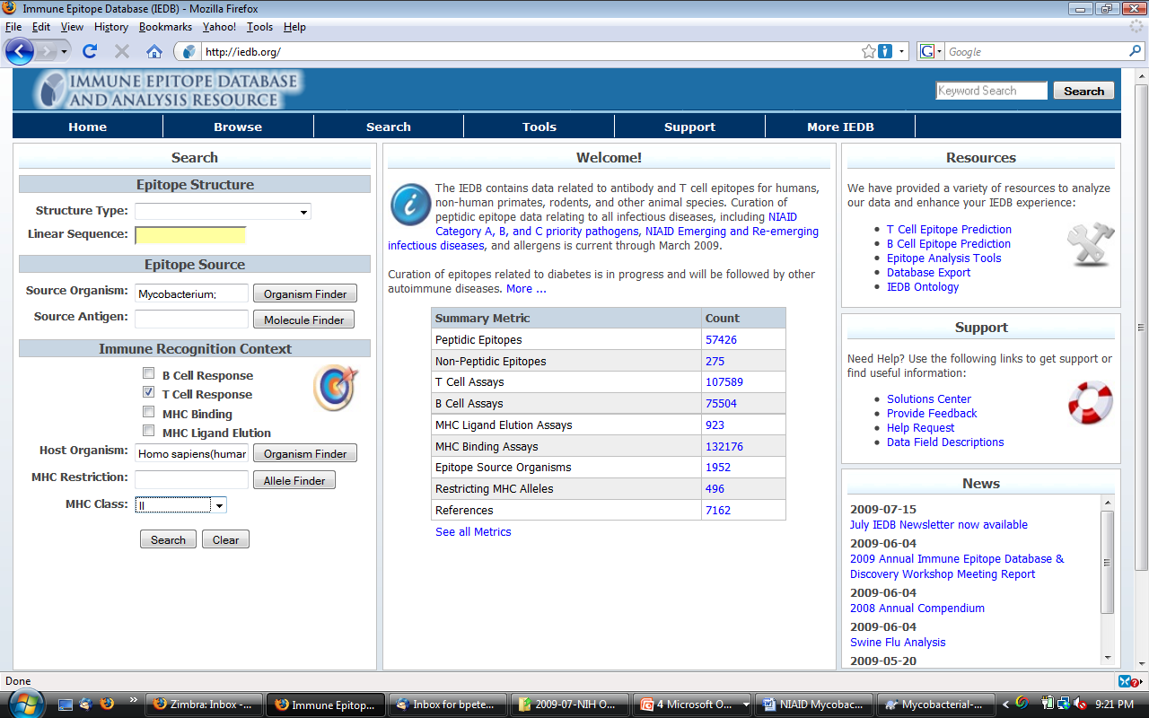

Slide 22
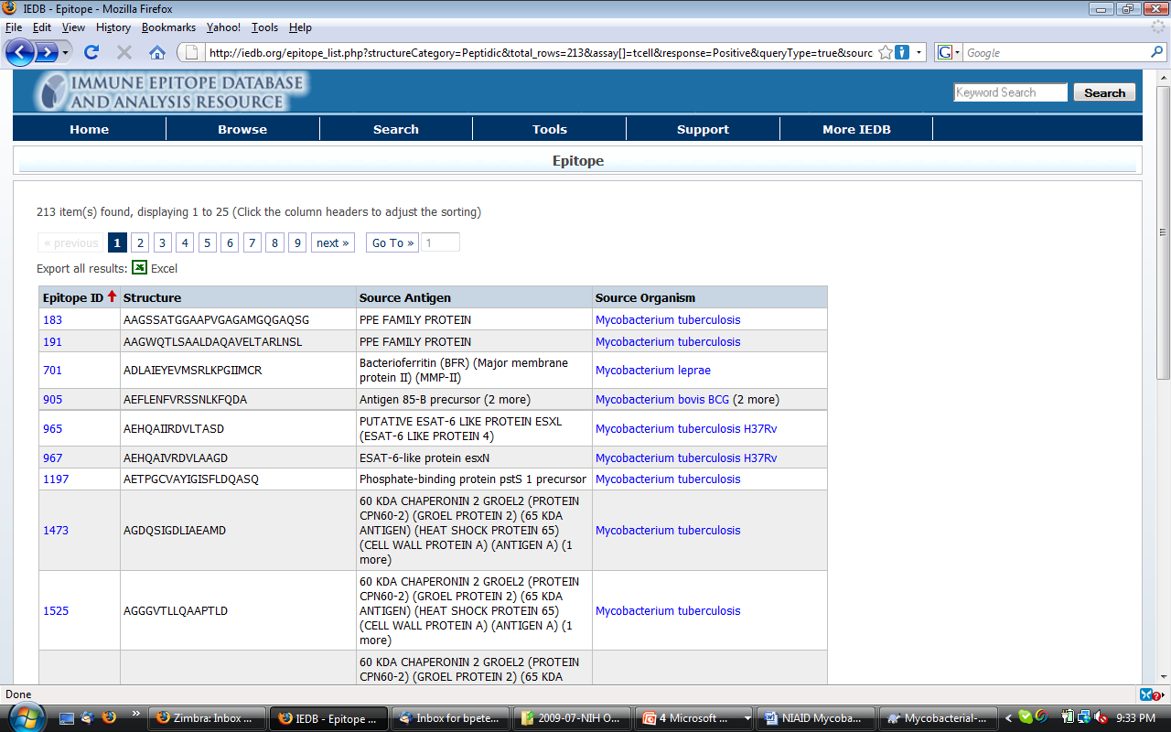

Slide 23
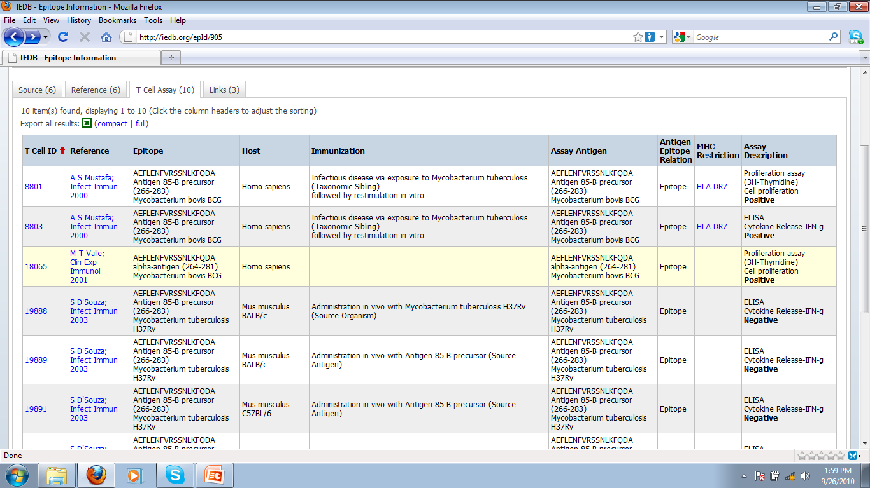

Slide 24
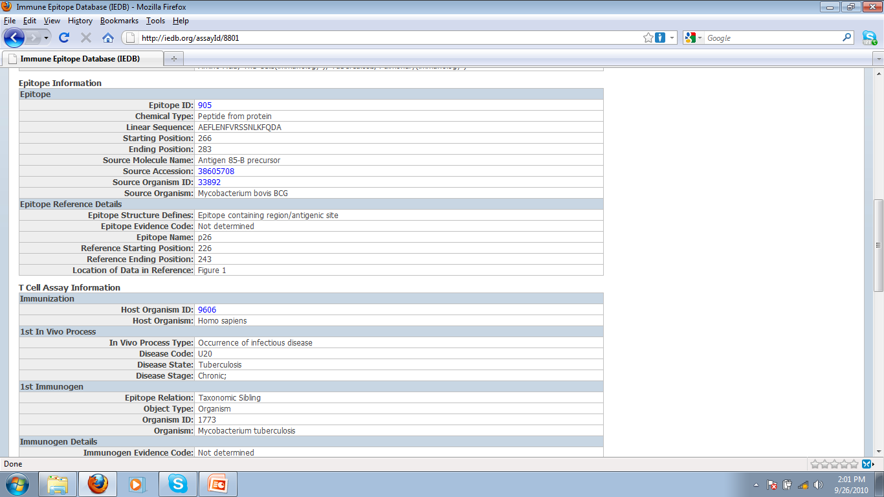

Slide 25
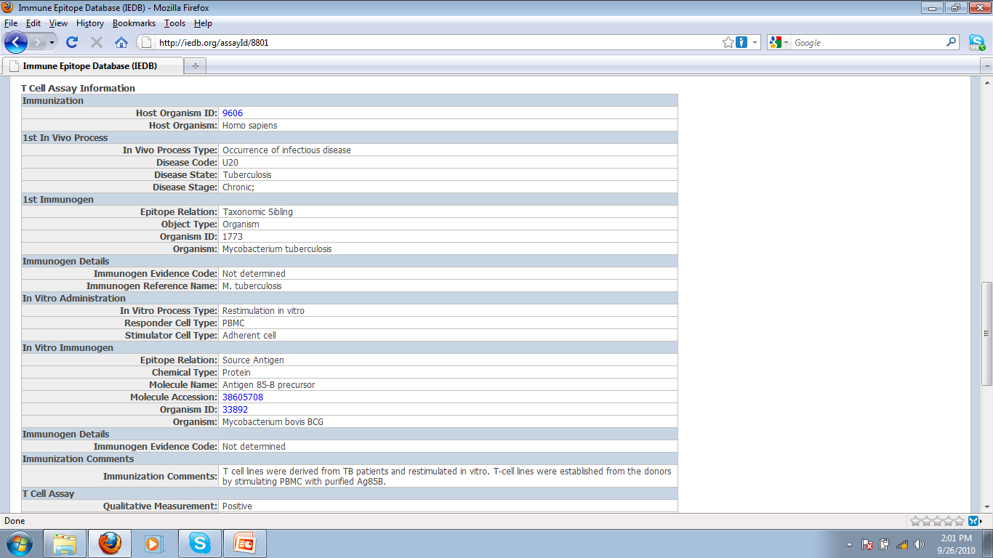

Slide 26
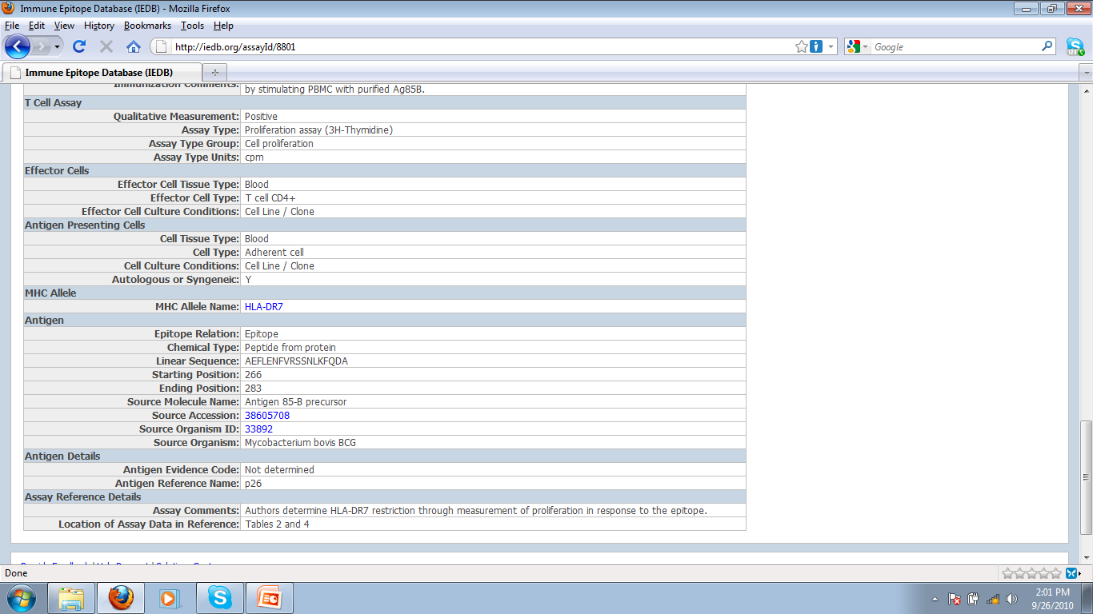

Slide 27
Original approach: controlled vocabularies
Used existing external ontologies as source where possible (none available for epitope specific T cell assays)
Maintain list of assays; if a publication uses an assay that is different, add to this list → 140 T cell assays
Challenges :
Ensure curators pick the right assays
Communicate to external users what each assay is
Avoid introducing duplicates (“MCP-1 IFA” = “CCL-2 histostain”)
In addition we want to
Search for groups of related assays
Interoperability (lots of it)
→ Create an OBI class for each entry in our list of assay types

Slide 28
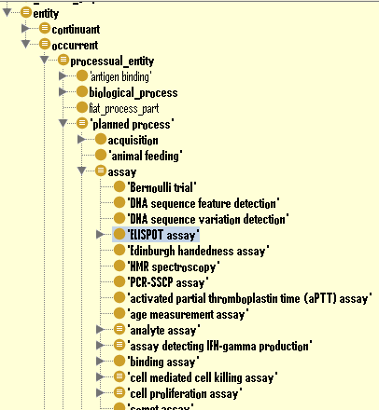
OBI hierarchy
Assay definition:
A planned process with the objective to produce information about an evaluant
OWL (partial):
has_specified_input some
(material_entity
and (has_role some 'evaluant role'))
has_specified_output some
('information content entity'
and ('is about' some
(continuant
and (has_role some 'evaluant role'))))

Slide 29
T cell epitope assay design pattern
Majority of assays could be defined with N&S conditions after specifying two variables:
<parent assay type> and has_specified_output some 'measurement datum‘ and 'is about' some (<GO process Y> and 'process is result of' some 'MHC:epitope complex binding to TCR')
For example: “IL-17 ELISPOT” in the IEDB is logically defined as
= 'ELISPOT assay‘ and has_specified_output some 'measurement datum‘ and 'is about' some (‘IL-17 production’ and process is result of' some 'MHC:epitope complex binding to TCR')
Required expanding parent assay types (OBI) and GO process

Slide 30
Adding parent assay types to OBI
label: cytometric bead array assay
definition: An assay in which a series of beads coated with antibodies specific for different analytes and marked with discrete fluorescent labels are used to simultaneously capture and quantitate soluble analytes using flow cytometric analysis.
alternative term: multiplexed bead assay, CBA assay
example of usage: Using a Luminex machine to detect IFN-gamma and IL-10 in the supernatant of a cell culture
“Parent” assay definitions are discussed in OBI as a group and derived by consensus, to ensure exactness and ability to re-use.
Child terms that follow design patterns are added without group discussion

Slide 31
Modifying external ontologies
Requests for new / modified terms are made through their respective trackers (sometimes additional prodding is needed)
Often results in email discussions that clarify issues and result in improved definitions (but take time)
Succeeded with GO, ChEBI, PRO, OGMS, IDO, PATO, UO, …
Resulting terms are imported into OBI to reference them in logical definitions (Using MIREOT mechanism explained in hands on session)
Some terms have no ‘natural home ontology’, and are kept in OBI until they can be moved

Slide 32
Mapping IEDB assay types to OBI classes
Spreadsheet based QTT template
(explained in hands on session)

Slide 33
Benefits of using OBI classes for IEDB assay types internally
Formal definitions of assay types serve as curation rules
Issues arising in curation are reflected 1:1 by issues in writing definitions
Linking to GO identified duplicate assay types (introduced in the IEDB controlled vocabulary as a result of changes in nomenclature over time)
The same could have been achieved by carefully writing definitions for our controlled vocabulary terms, but ontologies can do more…

Slide 34
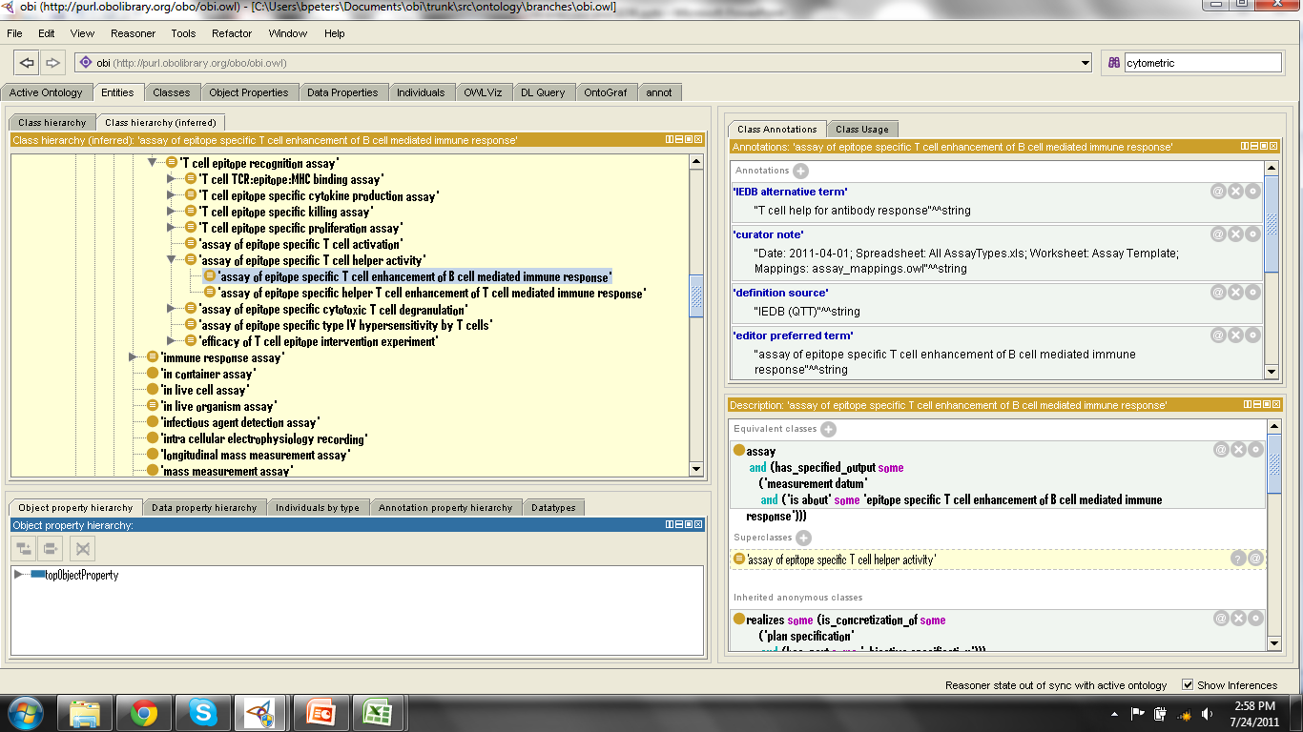
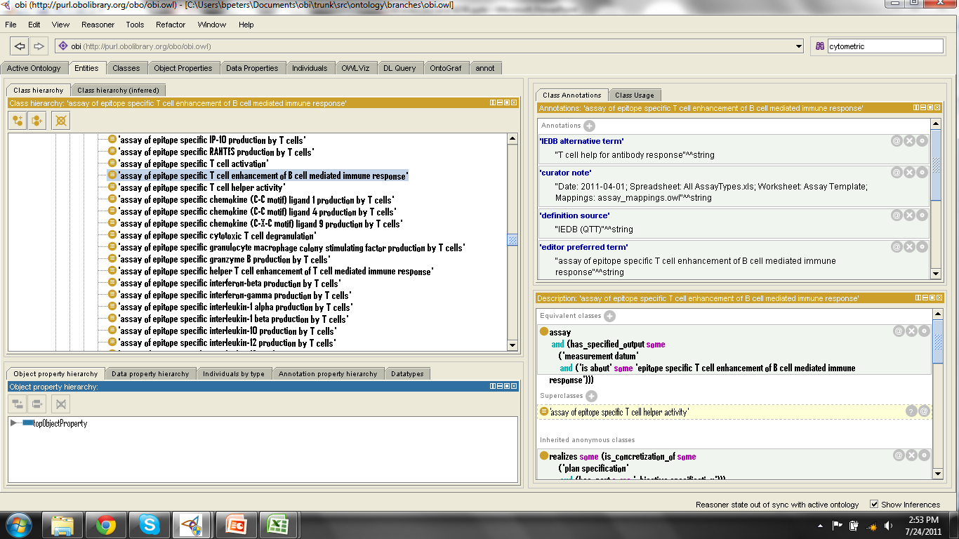
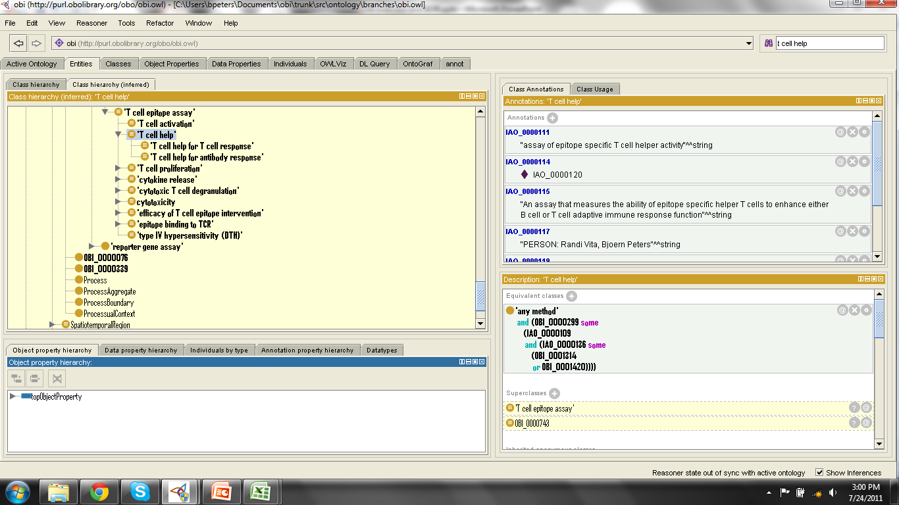
Reasoning introduces hierarchy
Display with community specific “IEDB alternative label”

Slide 35
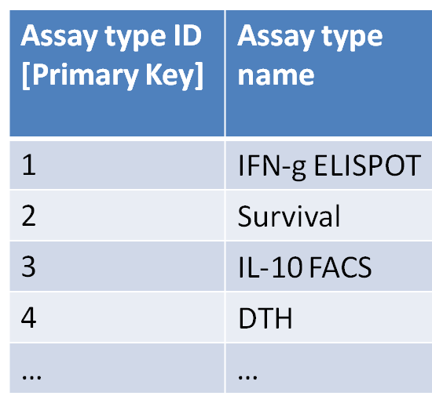
Benefits of using OBI for external users
Required (minimal) modification of the assay type table
Assay type ID [Primary Key] | Assay type name | Ontology ID [could be more than just OBI]
1 | IFN-g ELISPOT | http://purl.obolibrary.org/obo/OBI_0001414
2 | Survival | http://purl.obolibrary.org/obo/OBI_0001334
3 | IL-10 FACS | http://purl.obolibrary.org/obo/OBI_0000414
4 | DTH | http://purl.obolibrary.org/obo/OBI_0002114
… | … | …
→ This allowed us to use OBI

Slide 36
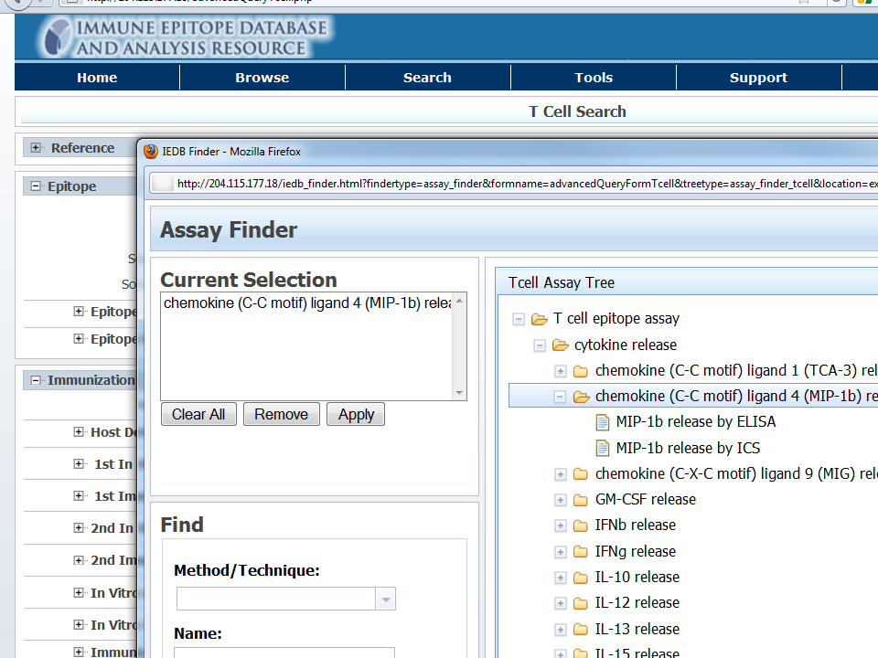
Ontology driven search interface
Search for groups of related assays
Search using synonyms
Use IEDB specific labels

Slide 37
Future work
Export IEDB data into triple store, enabling Sparql queries
→ seamless interoperability
Integration into rule based validation system

Slide 38
This presentation demonstrated:
How to replace a controlled vocabulary with OBI classes
How this can be used to
Increase consistency in data curation
Avoid duplicates
Improve documentation to external users
Enhance search capabilities

